Slide 1
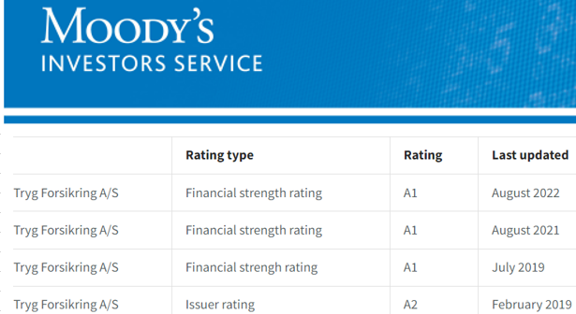
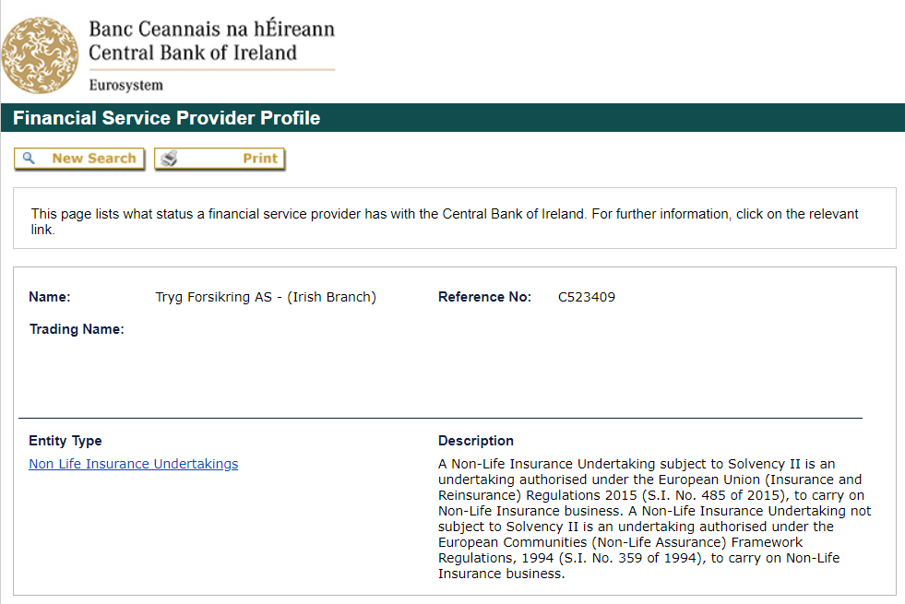
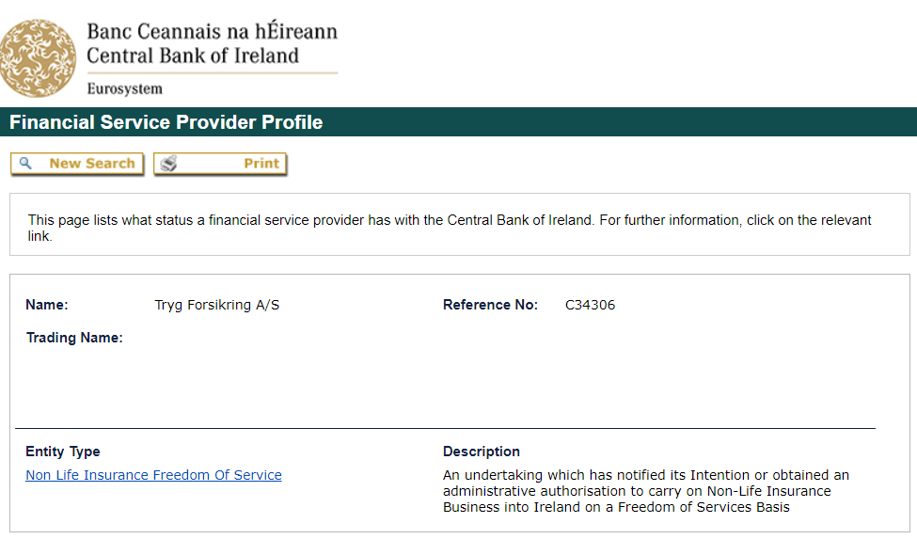
Tryg Garanti - Ireland
Tryg Garanti Ireland is a branch of Tryg Forsikring A/S and is registered with the Central Bank of Ireland.
Initially established in 1731, Tryg Forsikring A/S, based in Denmark is listed on the Copenhagen Stock Exchange (CPH: TRYG) and is the largest general insurer and provider of guarantee & credit insurance in the Nordic region.
Tryg Garanti have offices in Denmark, Norway, Sweden, Finland, Austria, Belgium, Germany, the Netherlands, the UK, Switzerland and Ireland.
Tryg has a solid balance sheet, with total assets of approximately €15bln at year end 2023 and a Moody’s Financial Strength Rating of A1/Stable.
Tryg Garanti Ireland are located at
Pembroke House,
28 Upper Pembroke Street
Dublin 2 D02 NT28
Phone: 00353 (01) 264-1765
Email: post@tryggaranti.ie

